Slide 1
Manufacturing For The Future

Slide 2
Video, press play at bottom of slide

Slide 3
C6-Zero Iowa LLC is a manufacturer of oil, biodiesel, blended oil, aggregate, and fiberglass from post consumer asphalt shingles and soy-bean oil.
Launching first factory for production in 2021 in Marengo IA
Privately held company with exclusive technology and processes
Launching from Marengo Iowa and growing to additional sites in 2022-2030

Slide 4
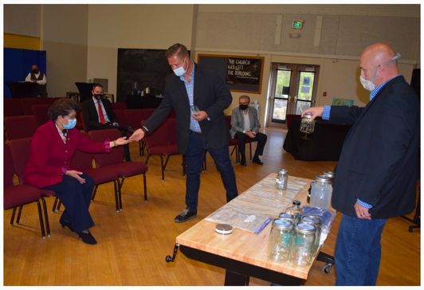
THE C6-ZERO SOLUTION
C6-Zero manufacturers every captured ton of waste shingles into:
2.38+/- Barrels of oil to be blended at site into Biofuel or bio-blend oil
.75+/- Yards of ATSM 33 aggregate
33.75+/- pounds of clean fiberglass
These are all sold back into the marketplace. We collect waste shingles and transport feedstock and end products via US rail
US Cabinet Member and SBA Administrator Janita Carranza
Howard Brand Founder C6-Zero
Chris Koehn Partner C6-Zero
November 2020

Slide 5
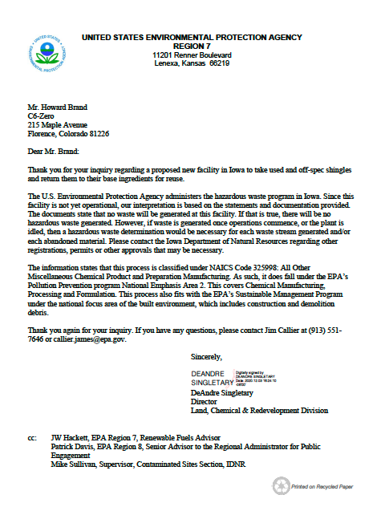
Market magnitude
11+ Million tons of waste shingles per year
26+ Million barrels of end-product oil or blended Biofuel per year
8+ Million tons of ASTM 33 aggregate per year
371+ Thousand tons of clean fiberglass per year
EPA Designation Letter December 2020

Slide 6
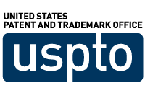
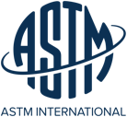
Process and Product
Patent – Domestic and International
EPA Designated as manufacturing, Pollution Prevention and within Sustainable Management Program
Process Mass Balance by Los Alamos Technical Laboratories/Associates
Fuel oil exceeds Marine Gasoil (MGO)
Soy Fuel Oil meets B100 specifications
Aggregate meets ATSM 33 specifications
Soy operations 2021-2022 Certified Organic Per USDA Standards

Slide 7
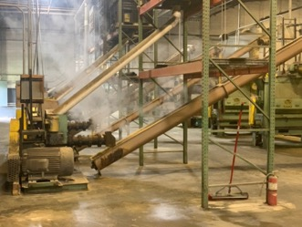
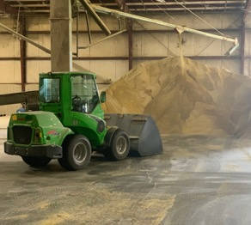
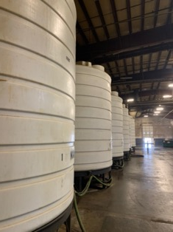
IOWA – Why Soybean Oil?
Organic soy processing operation to capture soy oil for the purpose of distilling into Bio-100 diesel (B-100)to splash blend with remanufactured shingle oil for higher market value and strategic value within select states and markets.
Owned proprietary distillate process and equipment for production of B-100.
C6 Soy Production

Slide 8
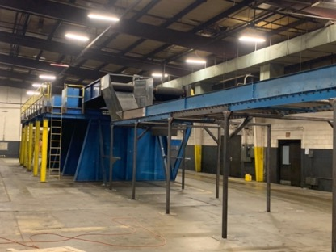
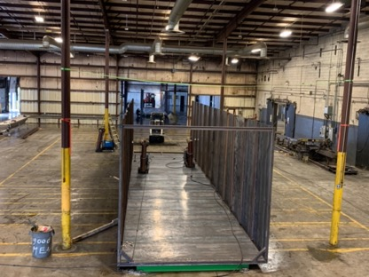
IOWA – MARENGO SITE
170+ Thousand SF Facility
Existing upgraded rail spur
Will house 2 shingle production systems
Site of soybean crush and distillate systems
73+ Million population within 500 miles
15+ Million homes within 500 miles
1.5+ Million Potential Roofs Per Year Market Potential
C6-Equipment Integration

Slide 9
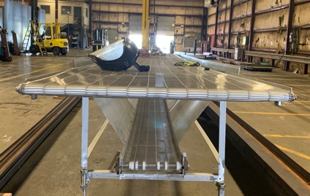
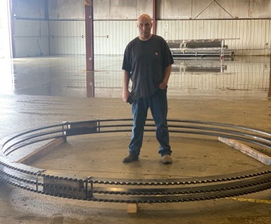
Expected Marengo Production
Single Production System - 970 plus tons of shingles processed daily
2300+ barrels of fuel oil (MGO) daily
Two Production Systems – 1900 plus tons of shingles processed daily
4600+ barrels of fuel oil (MGO) daily
C6-Equipment Integration

Slide 10
The Opportunity
Non-Ownership, Per Barrel Royalty Agreement Investment
Royalty per barrel per $100,000 invested
Multiple year
Uses
Second Production Line
Additional Site Improvements
Additional Raw Materials
C6-Equipment Integration

Slide 11
Contact:
Howard Brand
(970) 286-5787
Howard.brand@c6-zero.com
info@c6-zero.com
Manufacturing For The Future

